Slide 1
Test Automation
ZL Chen, SIoT DQA, Advantech

Slide 2
Agenda
What is Test Automation?
What is the Test Automation Pyramid?
What is difference between Test Automation and Automation Testing?
Automation Testing Tools for Introduction & Demo

Slide 3
What is Test Automation?
In software testing, test automation is the use of software separate from the software being tested to control the execution of tests and the comparison of actual outcomes with predicted outcomes.
Test automation can automate some repetitive but necessary tasks in a formalized testing process already in place, or perform additional testing that would be difficult to do manually. Test automation is critical for continuous delivery and continuous testing.

Slide 4
Why ???
Why Automation Needs Humans?
Why Automation?
Why Automation is NOT easy?
Why Automation Testing is important?

Slide 5
Why Automated Testing?
Automated testing is important due to following reasons:
Manual Testing of all work flows, all fields, all negative scenarios is time and cost consuming.
It is difficult to test for multilingual sites manually.
Automation does not require human intervention.
You can run automated test unattended (overnight).
Automation increases speed of test execution & test coverage.
Manual testing can become boring and hence error prone.

Slide 6
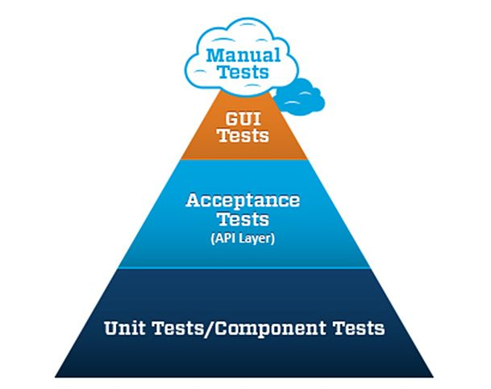
What is Test Automation Pyramid?
There are many approaches to test automation, however below are the general approaches used widely:
Graphical user interface testing
API driven testing
Unit testing

Slide 7
What is difference between Test Automation and Automation Testing?
Automated testing is the act of conducting specific tests via automation as opposed to conducting them manually. Just like a set of regression tests.
Test automation refers to automating the process of tracking and managing the different tests.

Slide 8
Automation Testing Tools for Introduction & Demo
Roaming automation
Airplane on/off mode automation
Android 6.0.1 (RJ-45), Android 6.0.1 (OTG)
Android 8.1.0 (RJ-45), Android 8.1.0 (OTG)
Windows
Wi-Fi frequency switch automation (2.4G, 5G)
Resolution automation
Luminance automation
PXE automatic installation
BurnInTest automation
Continuous Integration

Slide 9
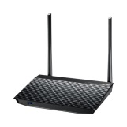
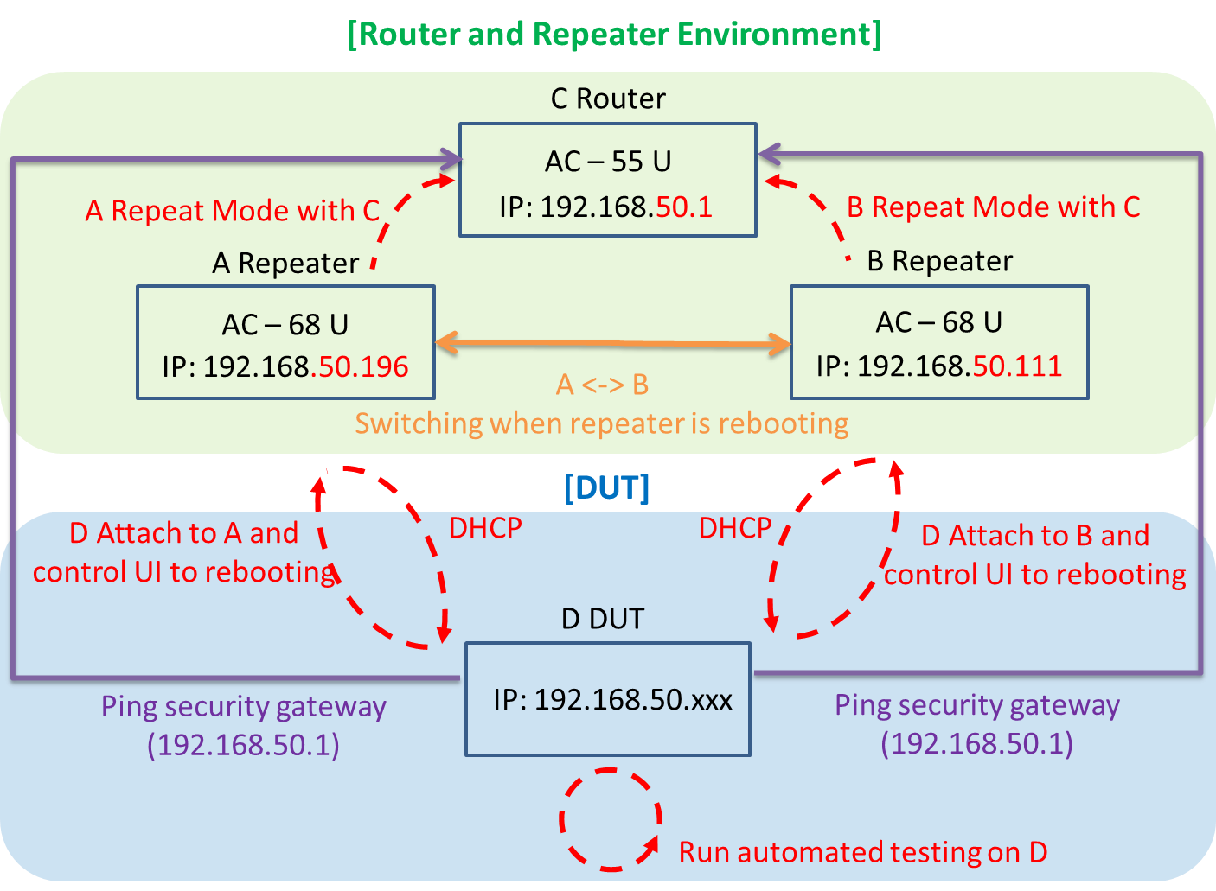

Roaming automation
System Structure

Slide 10
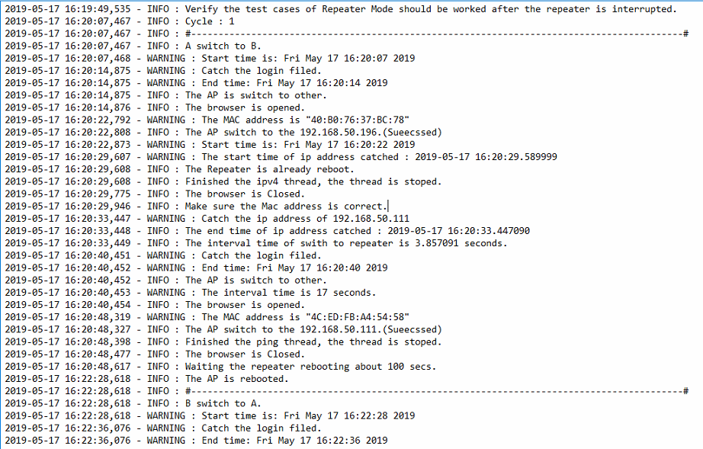
Roaming automation
The roaming’s log as below:

Slide 11
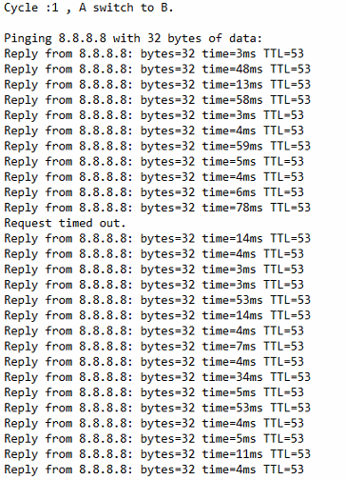
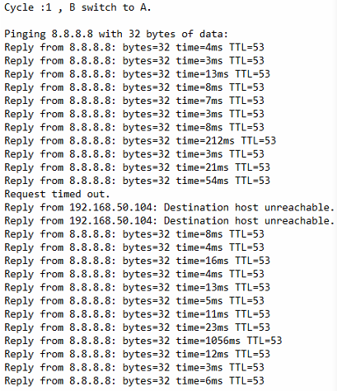
Roaming automation
The roaming’s ping log as below:

Slide 12
Roaming automation
Conclusion

Slide 13
Airplane on/off mode automation
Android 6.0.1 (RJ-45), Android 6.0.1 (OTG)
System Structure

Slide 14
Airplane on/off mode automation
Android 8.1.0 (RJ-45), Android 8.1.0 (OTG)
System Structure

Slide 15
Airplane on/off mode automation
Windows
System Structure

Slide 16
Airplane on/off mode automation
Conclusion

Slide 17
Wi-Fi frequency switch automation (2.4G, 5G)
System Structure

Slide 18
Wi-Fi frequency switch automation (2.4G, 5G)
Conclusion

Slide 19
Resolution automation
The Tool base on the GPU resolution
Auto catch the resolution by batch code
Auto catch the resolution by batch code. (Reboot)

Slide 20
Resolution automation
Conclusion

Slide 21
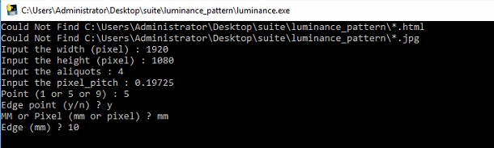
Luminance automation
The Tool base on the Product Specification
Width
Height
Aliquots
Pixel Pitch
Point
Edge

Slide 22





Luminance automation
The output luminance photo

Slide 23
Luminance automation
Conclusion

Slide 24
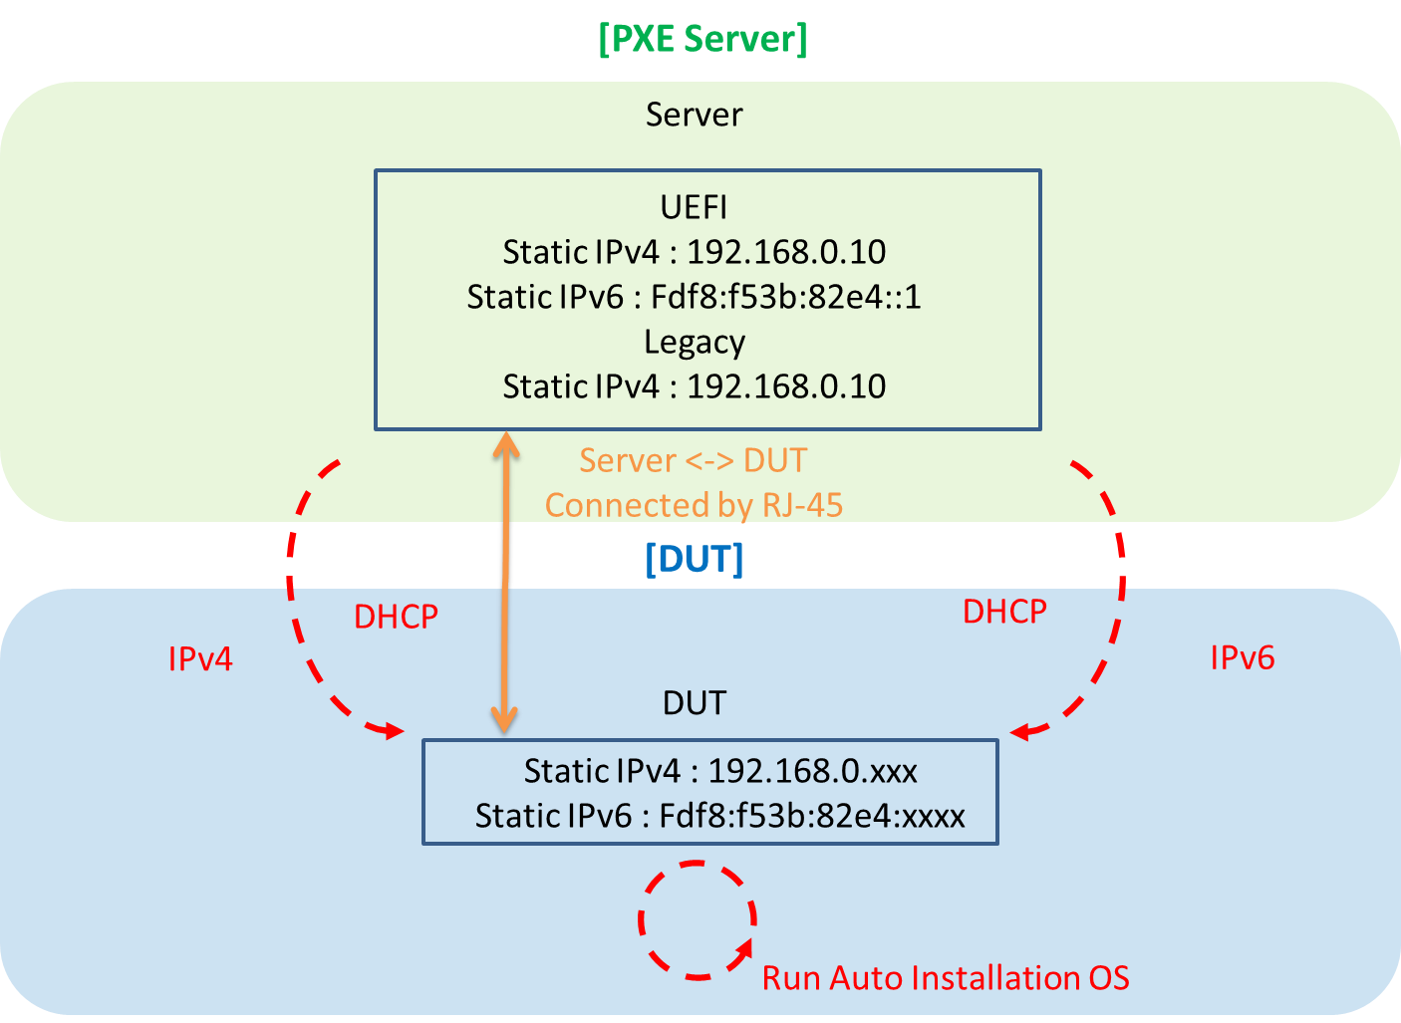
PXE automatic installation
System Structure

Slide 25
PXE automatic installation
Conclusion

Slide 26
BurnInTest Automation
System Structure

Slide 27
BurnInTest Automation
Conclusion

Slide 28
Continuous Integration
System Structure

Slide 29
Continuous Integration
Conclusion

Slide 30
Automation Tools hyperlink
\\172.17.9.225\dqa\iService\0G.DQA_Zone\50.Auto Test Tool\automation\suite

Slide 31
Go Together,
We Go Far and Grow Big

